Slide 1

Banking Recommendations for Users and Administrators
Owner : Team CodeBlooded

Slide 2
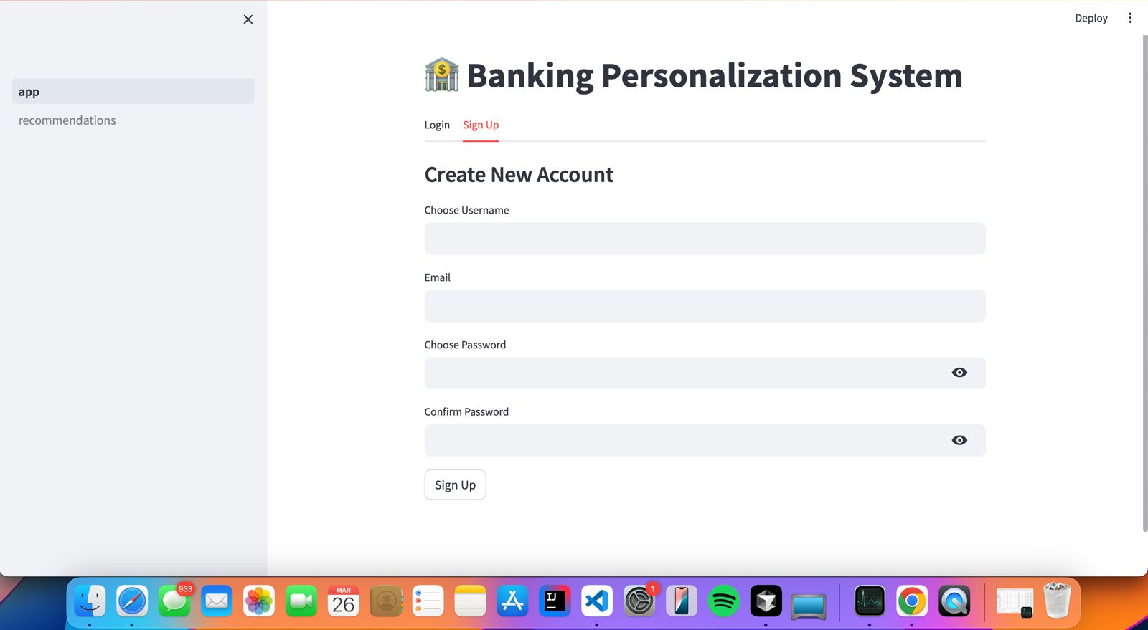
User Creation

Slide 3
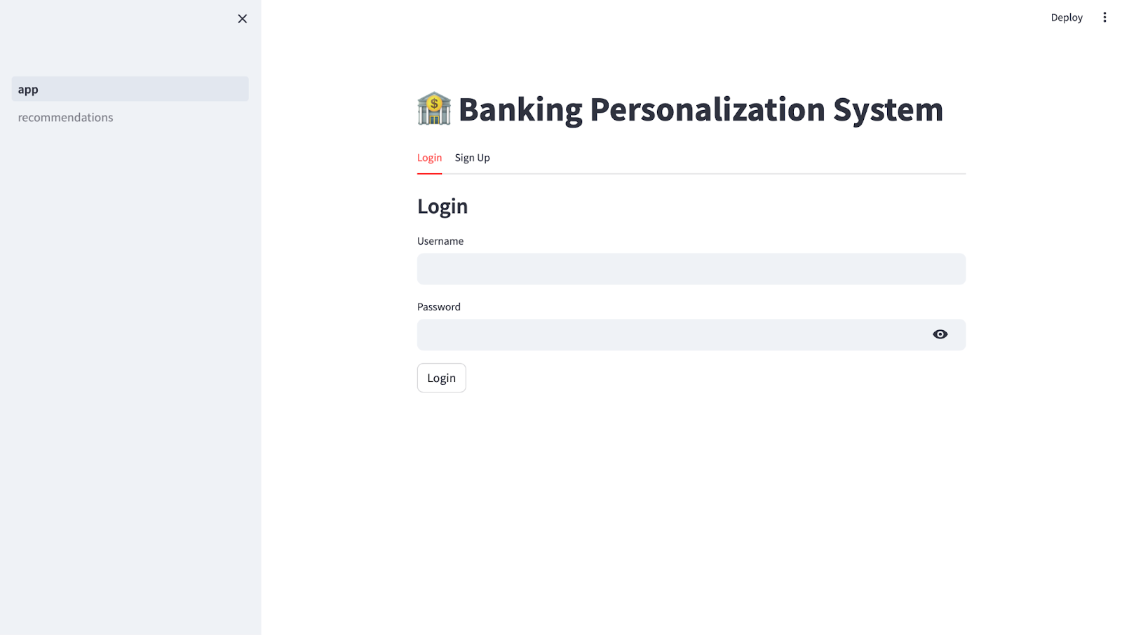
User Login: User can login using registered credentials

Slide 4
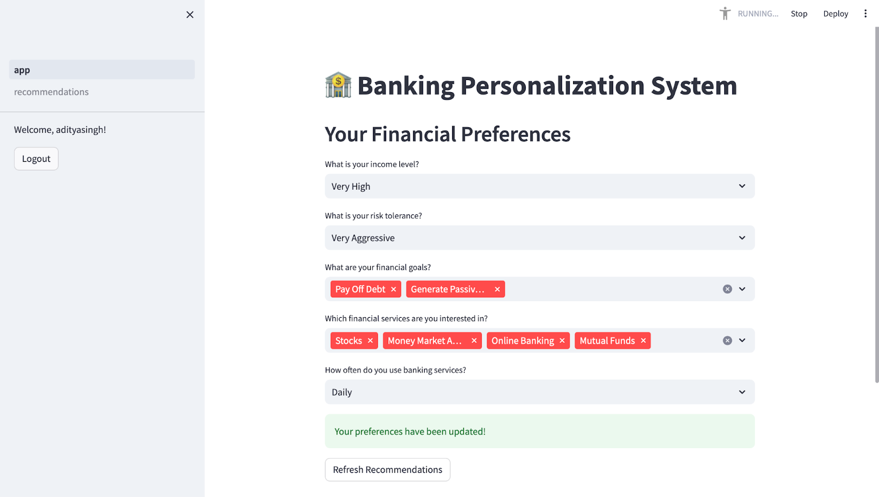
Select Financial Preferences: user can select displayed perferences

Slide 5
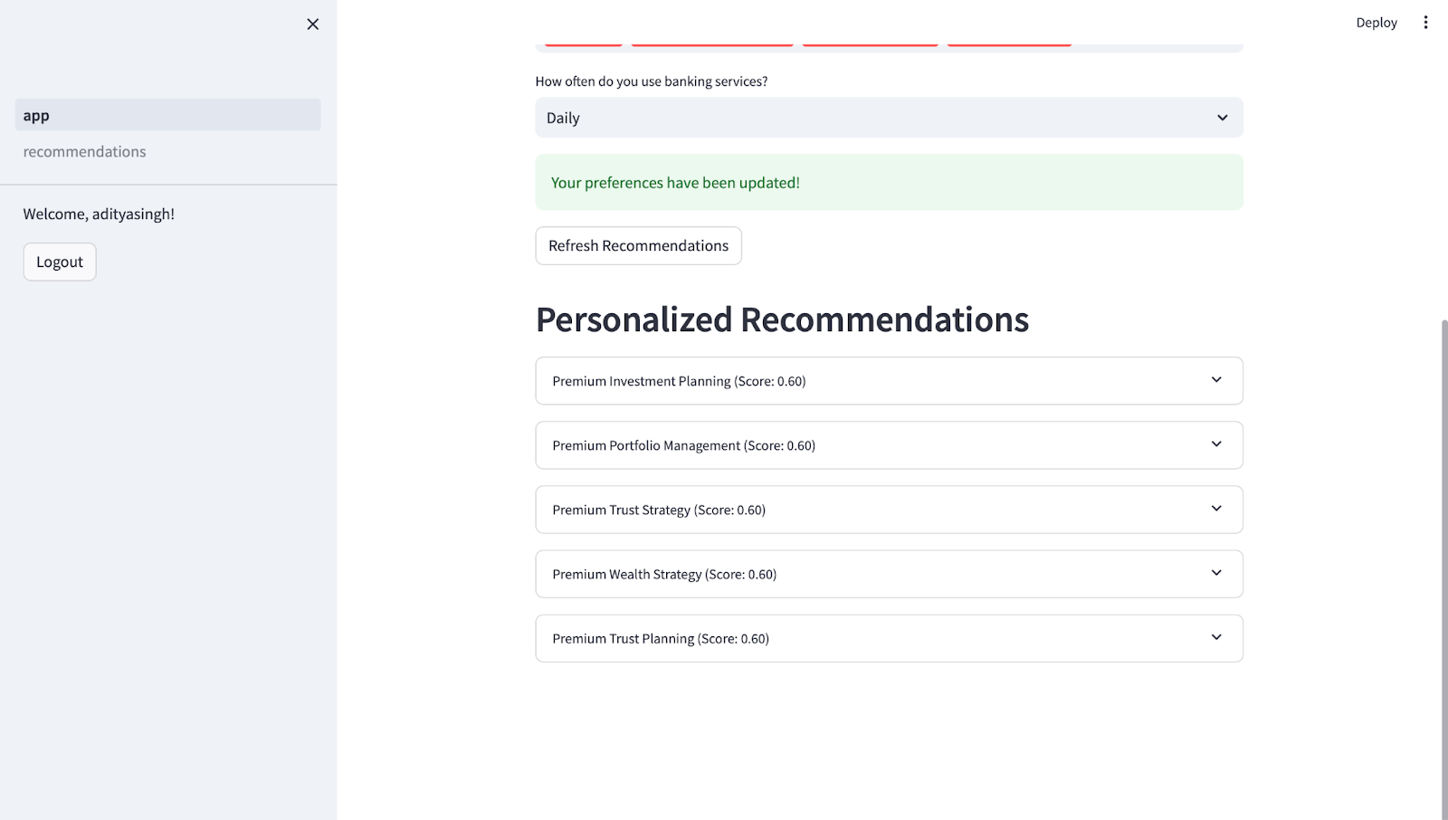
Personalized Recommendations

Slide 6
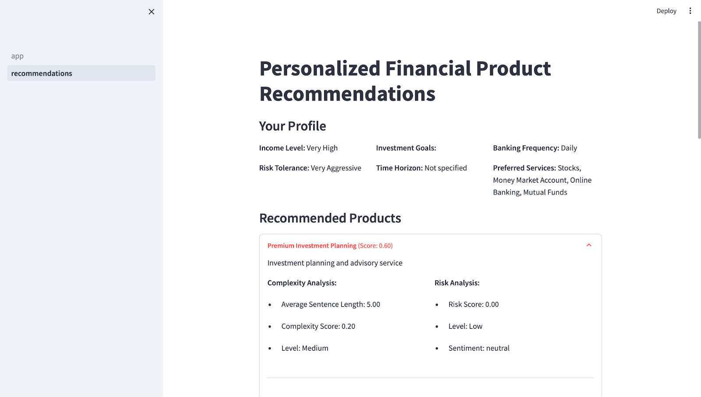
Personalized Financial Product Recommendations

Slide 7
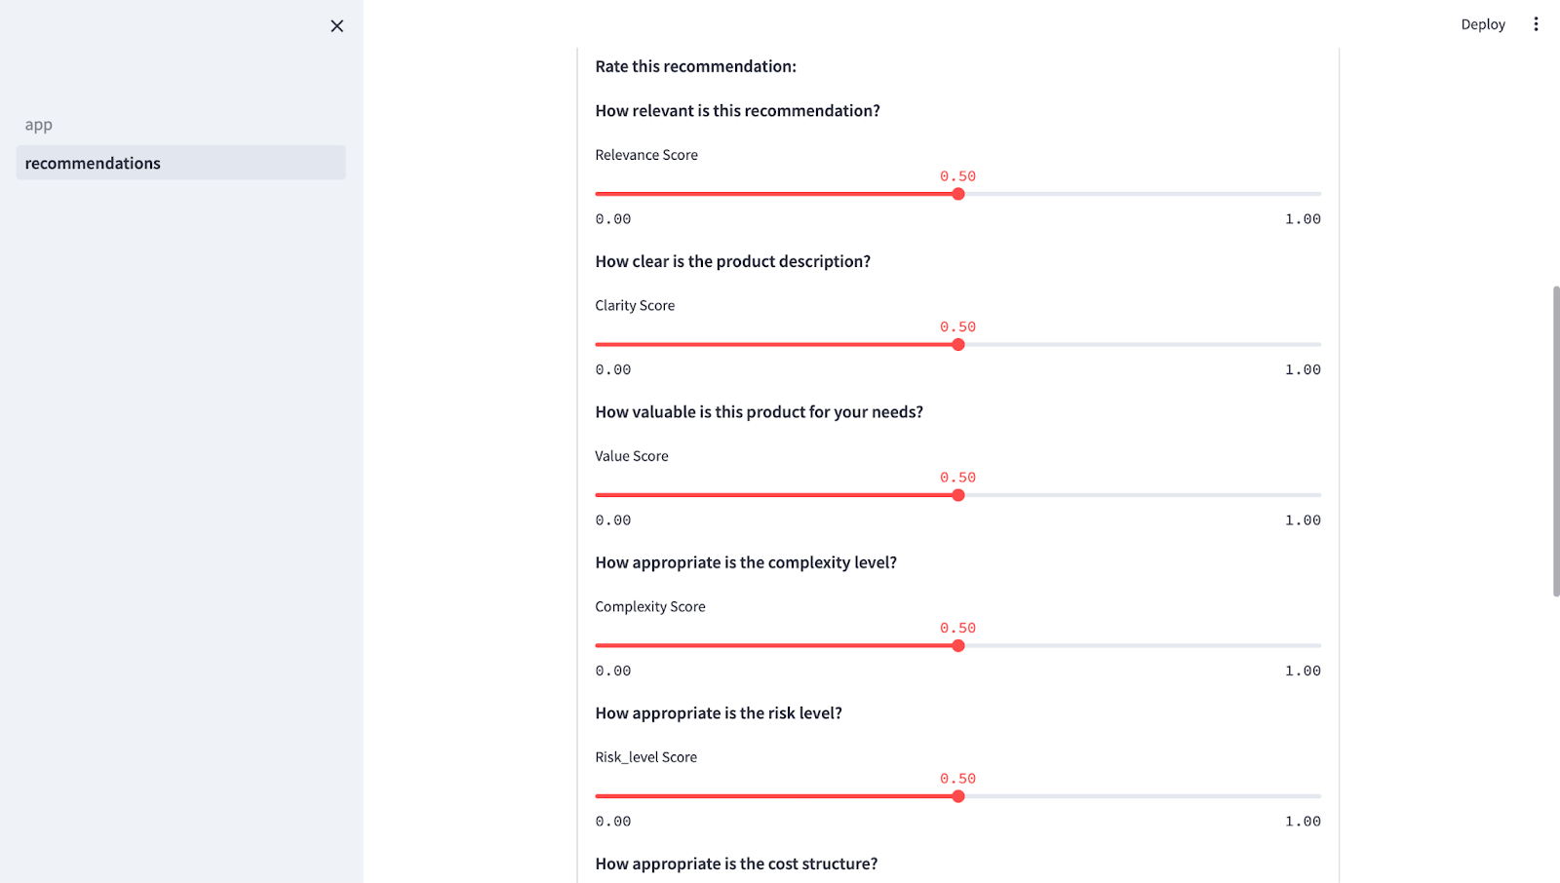
Rate Selected Recommendations

Slide 8
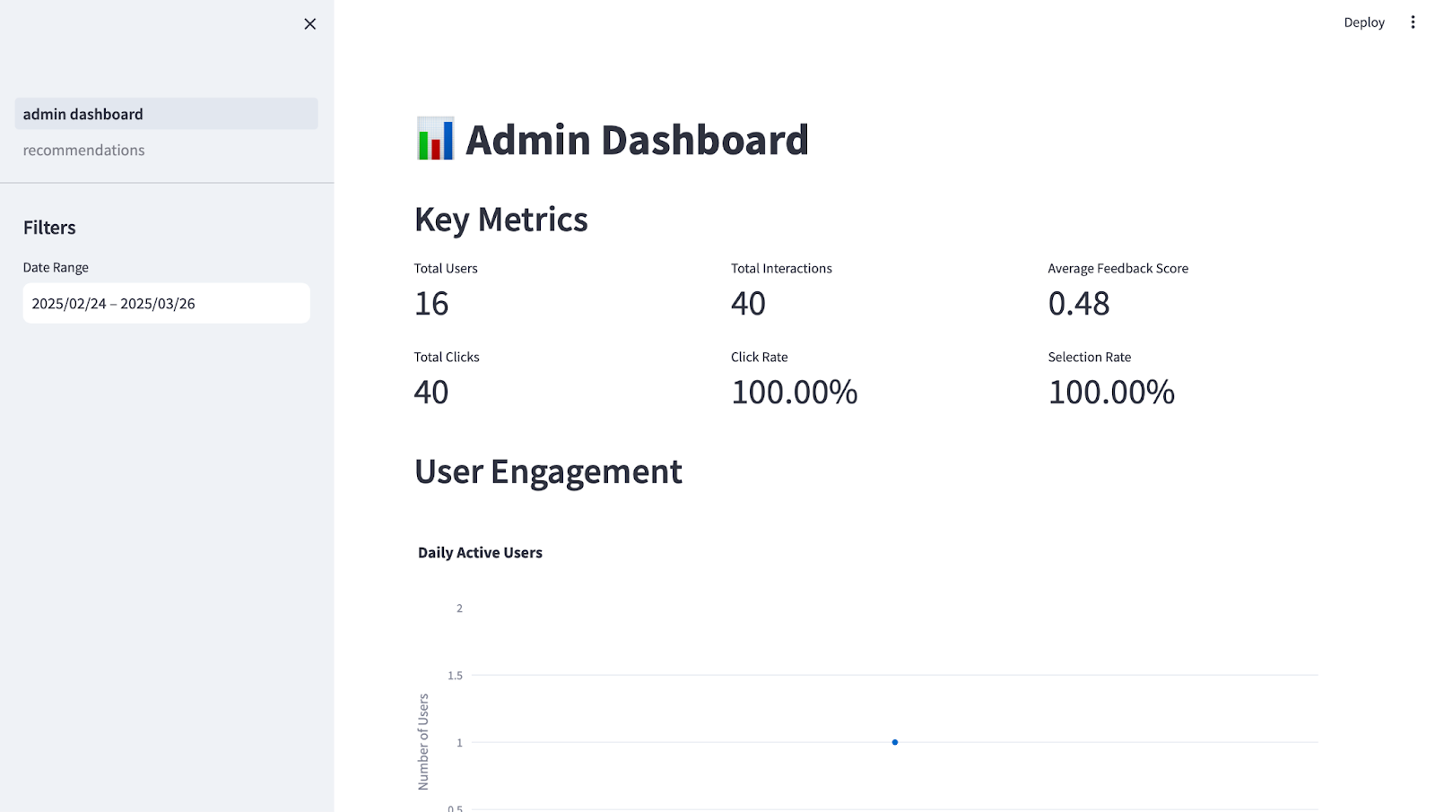
Admin Dashboard Screen: Admin can see the admin dashboard for key metrics and user engagement

Slide 9
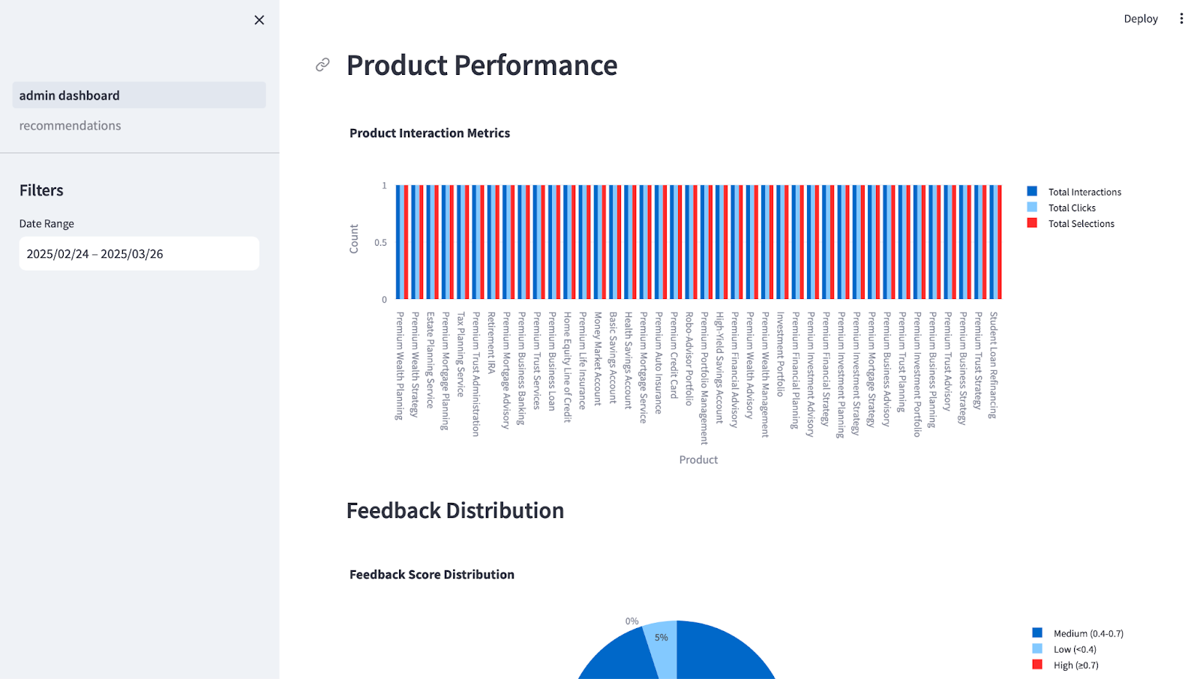
Product performance

Slide 10
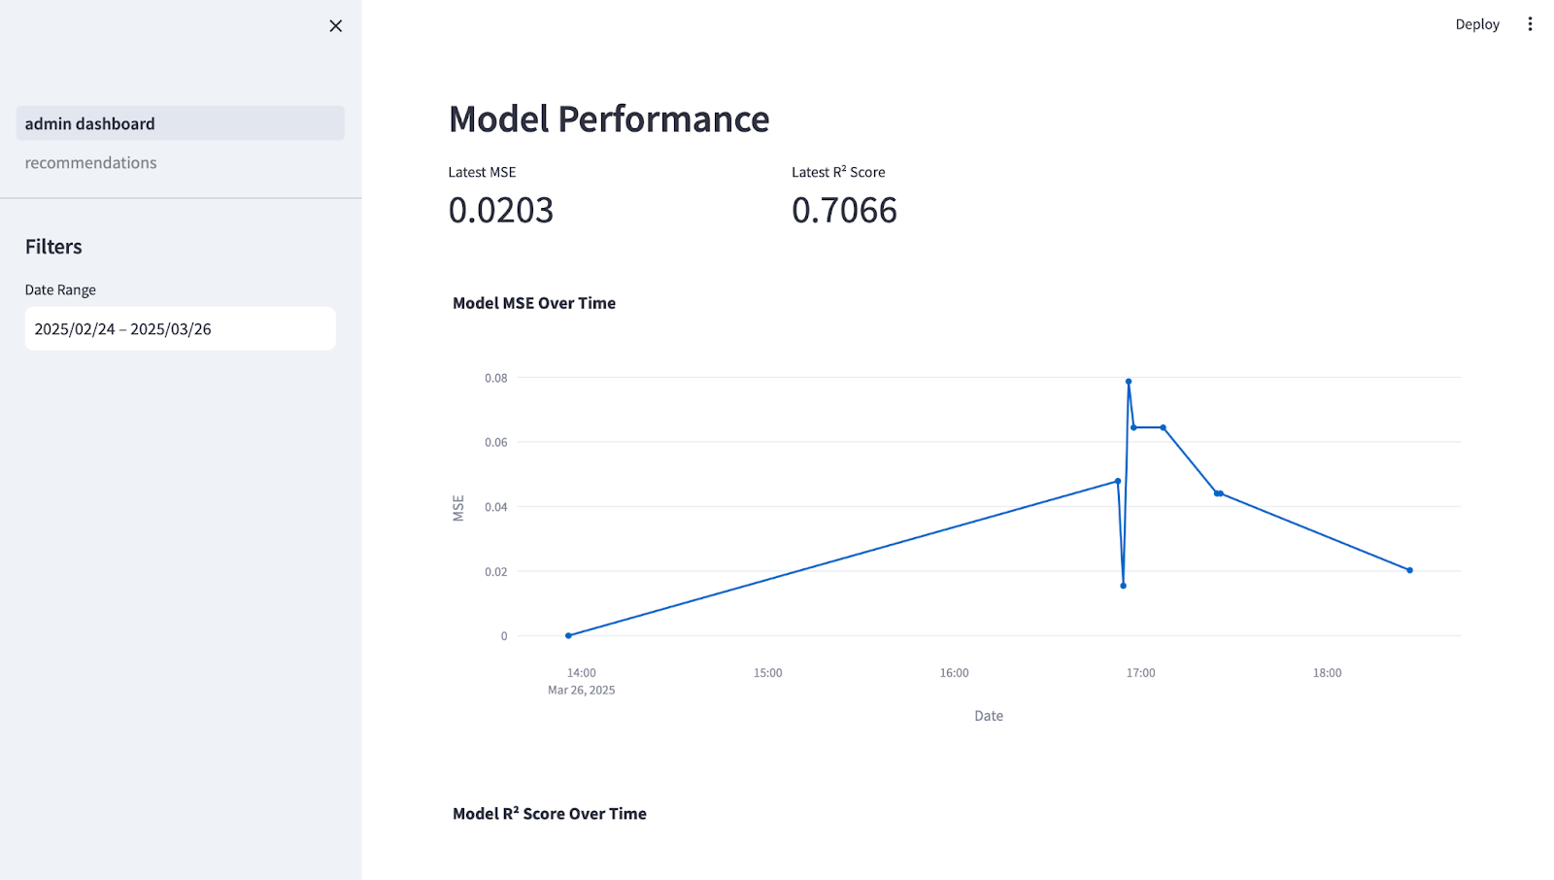
Model Performance

